Slide 1

Apple Financials & Stock Performance Analysis
By Dimas Diaz
August 12th

Slide 2
Analyze Apple’s stock performance over the past 5 years and compare it with financials. Develop key ratios, conduct trend analysis, and compare Apple’s financials to Microsoft.
Project Overview

Slide 3
Data Source/Tools
Data Sources:
Yahoo Finance – Historical Stock Dataset
Apple investor relations – 10k filings
Microsoft investor relation – 10k filings
Tools:
Excel – Perform ration analysis on financial statements
Power BI – Transform, model, and visualize data to identify trends, correlations, and insights

Slide 4
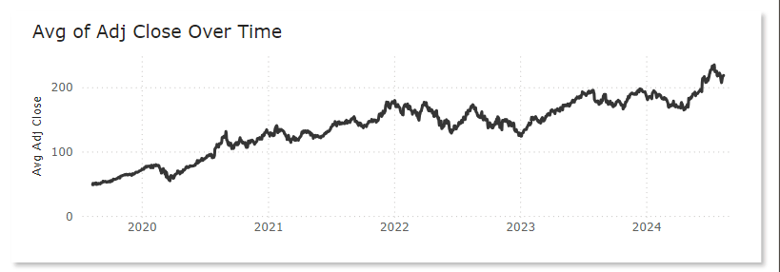
Has Apple’s Stock Increased?

Slide 5
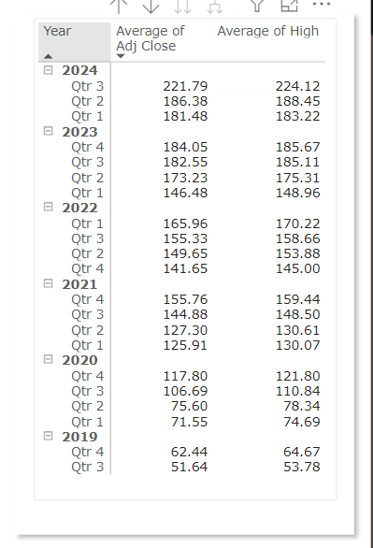
How does Apple’s stock perform over the years?
Qtr 3 of 2024 has seen a big jump in the average of adj close. Over the years Apple’s stock has been increasing gradually.

Slide 6
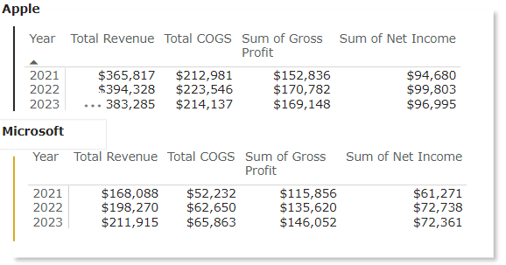

Apple’s comparison to Microsoft
Financials

Slide 7
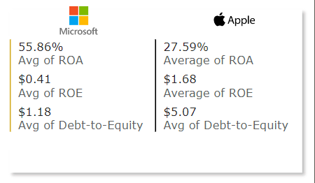
Apple comparison to Microsoft
Key Metrics

Slide 8
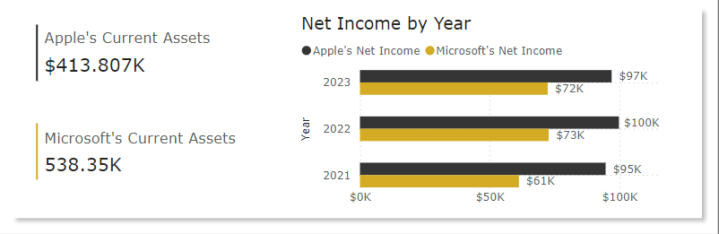
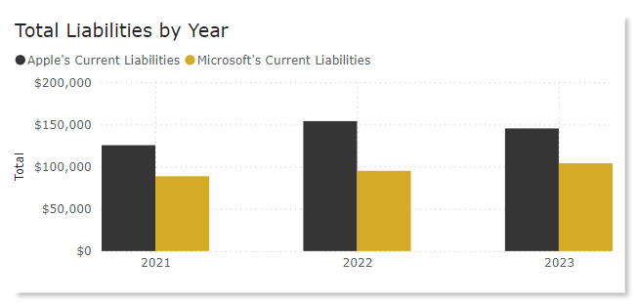
Apple comparison - Microsoft
Current Assets
Total Liabilities

Slide 9
Results/Findings

Slide 10
Recommendations

Slide 11
Limitations

Slide 12
Conclusion

